Slide 1
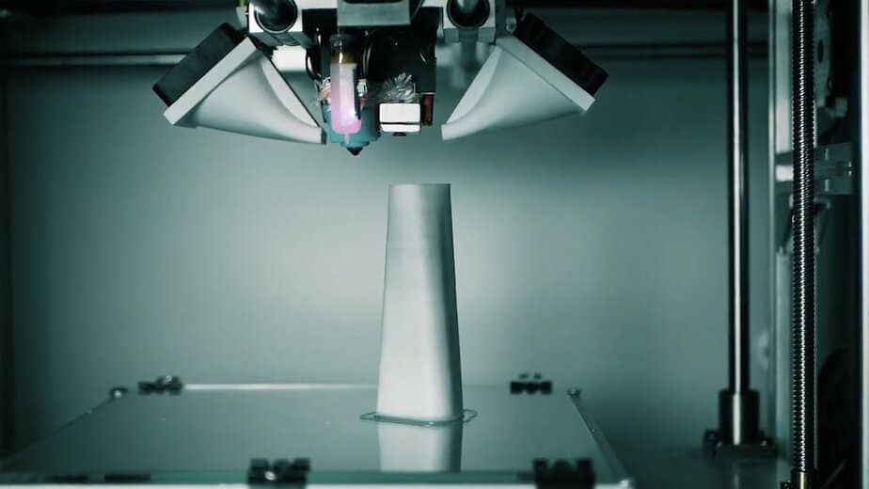



Prepared by Nikshita Ranganathan, Archit Barua
Shyamala Venkatakrishnan, Heejae Roh
Professor Venkata Duvvuri
June 29th, 2023
Final Presentation
Notes:
Source(northeastern mark): https://brand.northeastern.edu/visual-identity/university-wordmarks/
Source(3DHEALS logo): https://logovectordl.com/3dheals-llc-logo-vector-svg/
Source: https://3dheals.com/interview-with-denys-gurak-a-d-a-m-and-3d-printed-bones/
Color: https://3dheals.com/

Slide 2

Executive Summary
01
04
Clear Concise Flow
Business Problem
02
05
Analysis and synthesis
of the data
Building Customer email lookalikes
Analytics & Visuals
03
06
Recommendations & Findings
Exploratory Data Analysis
& Predictive Model
Notes:
Source(3DHEALS logo): https://logovectordl.com/3dheals-llc-logo-vector-svg/
Source(background): https://www.fastradius.com/resources/video-lattice-design-and-foam-replacement-in-3d-printing/
Color: https://3dheals.com/

Slide 3
Executive Summary
01
Notes:
Source(3DHEALS logo): https://logovectordl.com/3dheals-llc-logo-vector-svg/
Source(background): https://www.fastradius.com/resources/video-lattice-design-and-foam-replacement-in-3d-printing/
Color: https://3dheals.com/

Slide 4
Executive Summary
Our project aims to address the business objectives of our client through advanced analytics and machine learning techniques.
We employ Python for data cleansing, manipulation, and model creation, Excel for initial data exploration, and Tableau for data
visualization.
Key milestones include project setup, data acquisition and exploration, model development, applying models to address business
objectives, visualization of analysis results, impact analysis, and quality assurance.
Each team member has specific assignments aligned with their skills, including data analysis, model building, business research, and
project management.
Risks such as data quality, model inaccuracy, overfitting, team coordination, changing business objectives, and security breaches are
identified and addressed through mitigation strategies.
Success metrics include model performance, alignment with business objectives, user acceptance, value created, timely delivery, and
risk mitigation.
The proof of concept will be presented through a structured approach, incorporating clear communication, compelling visualizations,
live demonstrations, and interactive sessions.
The executive summary highlights the project's focus, approach, milestones, team assignments, risk mitigation strategies, success metrics and the presentation method for the proof of concept.
Overall, our project aims to deliver actionable insights and recommendations that align with the client's business objectives and
contribute to their strategic goals.
Notes:
Source(3DHEALS logo): https://logovectordl.com/3dheals-llc-logo-vector-svg/
Source(background): https://www.fastradius.com/resources/video-lattice-design-and-foam-replacement-in-3d-printing/
Color: https://3dheals.com/

Slide 5
Business
Problem
02
SWOT & Building Customer email lookalikes
Notes:
Source(3DHEALS logo): https://logovectordl.com/3dheals-llc-logo-vector-svg/
Source(background): https://www.fastradius.com/resources/video-lattice-design-and-foam-replacement-in-3d-printing/
Color: https://3dheals.com/

Slide 6
Company Details – 3DHeals
Industry: Healthcare Technology
Headquarters: San Francisco, California
Founded Year: 2015
Founder: Jenny Chen, MD
Mission: Promoting collaboration, knowledge exchange, and adoption of 3D printing in healthcare.
Services: Events, online education, consulting, community building, startup support, R&D
Competitors: Stratasys, 3D Systems, and Organovo
Accomplishments:
2016 Frost & Sullivan Award for Medical Device Innovation
2017 Fast Company World Changing Ideas Award
2018 Forbes Next Billion-Dollar Startups
Notes:
Source(3DHEALS logo): https://logovectordl.com/3dheals-llc-logo-vector-svg/
Source(background): https://www.fastradius.com/resources/video-lattice-design-and-foam-replacement-in-3d-printing/
Color: https://3dheals.com/

Slide 7
SWOT Analysis of 3DHEALS
Strengths
Opportunities
Domain expertise: Specialized knowledge in 3D printing and bioprinting.
Innovation and technology adoption: Staying at the forefront of advancements like AI.
Customization and personalization: Tailored solutions for individual patients.
Strong network and partnerships: Relationships with hospitals, research institutions, and manufacturers.
Growing demand for personalized medicine: Expanding market share with tailored healthcare solutions.
Advancements in AI and data analysis: Improving efficiency and accuracy in the 3D printing process.
Collaboration with healthcare providers: Accessing new markets and increasing sales through partnerships.
Research and development: Driving growth and competitiveness through innovative products and technologies.
Weaknesses
Threats
Limited market awareness: Challenges in increasing visibility and expanding customer base.
High production costs: Expensive technologies affecting affordability in certain markets.
Dependence on skilled workforce: Difficulty scaling operations due to specialized expertise.
Competition: Challenges from other companies offering similar products and services.
Regulatory challenges: Strict regulations impacting speed and cost of bringing new products to market.
Technological disruption: Rapid advancements potentially outpacing current capabilities.
Intellectual property protection: Ensuring protection of proprietary technologies, designs, and processes.
Notes:
Source(3DHEALS logo): https://logovectordl.com/3dheals-llc-logo-vector-svg/
Source(background): https://www.fastradius.com/resources/video-lattice-design-and-foam-replacement-in-3d-printing/
Color: https://3dheals.com/

Slide 8
Business Problem
Attendee Segmentation: Cluster attendees based on 'Industry', 'Organization', 'Job Title', 'Country/Region', and 'Source Name' for enhanced understanding of attendee demographics.
Event Attendance Prediction: Utilize features like 'Industry', 'Organization', 'Job Title', 'Country/Region', etc., to predict likely attendance for future events.
Webinar/Session Optimization: Analyze 'Time in Session (minutes)', 'Join Time', 'Leave Time', and 'Questions & Comments' to optimize the timing and content of sessions.
Consent Management: Observe fields related to consent to understand attendee comfort levels with data sharing and recording, thereby improving data usage planning and addressing privacy concerns.
Sponsorship Analysis: If 'Source Name' indicates sponsors, analyze the success of different sponsors in attracting attendees.
Attendee Origin Analysis: Examine 'Country/Region', 'City', 'State/Province', and 'Zip/Postal Code' to gain insights into the geographical distribution of attendees for targeted marketing efforts.
Marketing Channel Effectiveness: Analyze 'Email' domain, 'Linkedin Link', and 'Source Name' to determine which marketing channels drive the highest event attendance.
Session Feedback Analysis: Mine 'Questions & Comments' for insights about the sessions' strengths and areas for improvement.
Notes:
Source(3DHEALS logo): https://logovectordl.com/3dheals-llc-logo-vector-svg/
Source(background): https://www.fastradius.com/resources/video-lattice-design-and-foam-replacement-in-3d-printing/
Color: https://3dheals.com/

Slide 9
Analytics
& Visuals
03
Predictive Model & Exploratory Data Analysis
Notes:
Source(3DHEALS logo): https://logovectordl.com/3dheals-llc-logo-vector-svg/
Source(background): https://www.fastradius.com/resources/video-lattice-design-and-foam-replacement-in-3d-printing/
Color: https://3dheals.com/

Slide 10
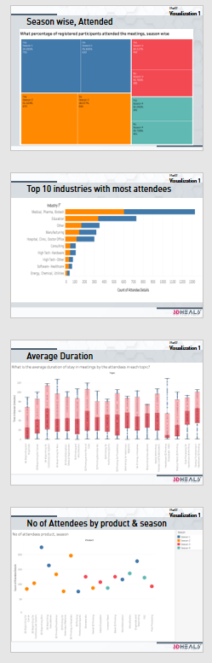
Summary of EDA 1
Over the course of four seasons, there was a gradual decrease in both the number of registrations and attendees for the meetings, with Season 1 having 1388 and Season 4 having 686 registrations.
Almost half of the registered members have not attended the meetings across all seasons.
The medical industry had the highest number of attendees at the meetings, followed by the education and manufacturing industries.
The topic '3D Bioprinting for Cardiovascular System' had the highest average duration of stay among attendees at 65 minutes. In contrast, the topic 'Healthcare 3D Printing Ecosystem: India' had the least average duration of stay among attendees at 7 minutes.
The meeting about the product '3D Bioprinting Skin', held during Season 1, had the maximum number of attendees at 250.
Notes:
Source(3DHEALS logo): https://logovectordl.com/3dheals-llc-logo-vector-svg/
Source(background): https://www.fastradius.com/resources/video-lattice-design-and-foam-replacement-in-3d-printing/
Color: https://3dheals.com/

Slide 11
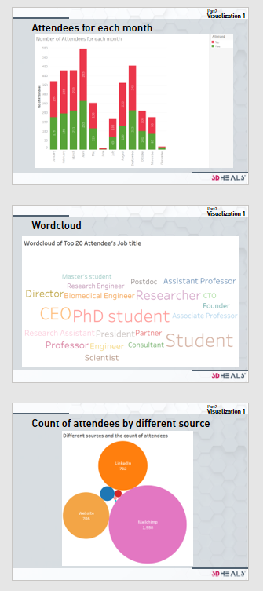
Summary of EDA 2
April had the highest number of attendees who answered "No" (283) and "Yes" (263), followed by September and March. The lowest attendance rates were in June and December. This may be due to a variety of factors like holidays, weather conditions, and marketing efforts.
The meeting had a diverse range of attendees, including many students and professionals such as CEOs, Directors, professors, and researchers. Students likely attended to gain knowledge and networking opportunities in the 3D printing and healthcare industries.
The attendees of the meeting learned about the 3DHeals event from a variety of sources, with the highest number coming from Mailchimp, followed by LinkedIn and other websites.
Notes:
Source(3DHEALS logo): https://logovectordl.com/3dheals-llc-logo-vector-svg/
Source(background): https://www.fastradius.com/resources/video-lattice-design-and-foam-replacement-in-3d-printing/
Color: https://3dheals.com/

Slide 12
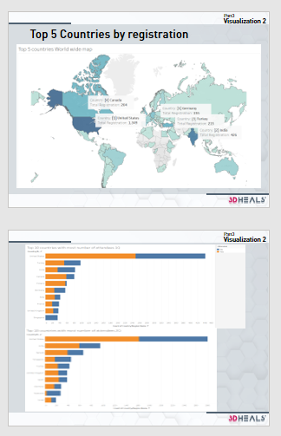
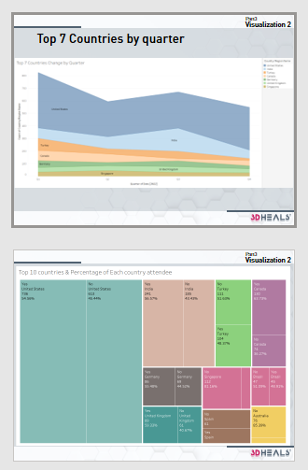
Summary of EDA 3
The top 5 registration by country was the United States with 1,349, followed by India with 426, followed by Turkey, Canada and Germany.
Checking the top 10 countries by each quarter, except top 5 countries in world wide, there are mainly European countries such as the UK and Spain. There are also Singapore, Australia, Israel and Brazil.
Top 7 countries by the number of registrations in each country by quarter fluctuated rather than constant.
In attendance rate by country, most of them were almost 50% attending and 50% not attending. Among the top 10 countries, Singapore shows 81%, Australia shows 85% not attended. On the other hand, Canada has the highest attendance rate at 63%, followed by the UK and Germany with 59% and 55%.
By proportions of the total attendees, the United States accounted for a quarter, followed by India with 8%, Turkey with 3.5% and Canada with 4.5%. Overall registrations were higher in Turkey, but due to attendance rates, the number of attendees in Canada was higher.
Notes:
Source(3DHEALS logo): https://logovectordl.com/3dheals-llc-logo-vector-svg/
Source(background): https://www.fastradius.com/resources/video-lattice-design-and-foam-replacement-in-3d-printing/
Color: https://3dheals.com/

Slide 13
Clear Concise Flow
04
Notes:
Source(3DHEALS logo): https://logovectordl.com/3dheals-llc-logo-vector-svg/
Source(background): https://www.fastradius.com/resources/video-lattice-design-and-foam-replacement-in-3d-printing/
Color: https://3dheals.com/

Slide 14
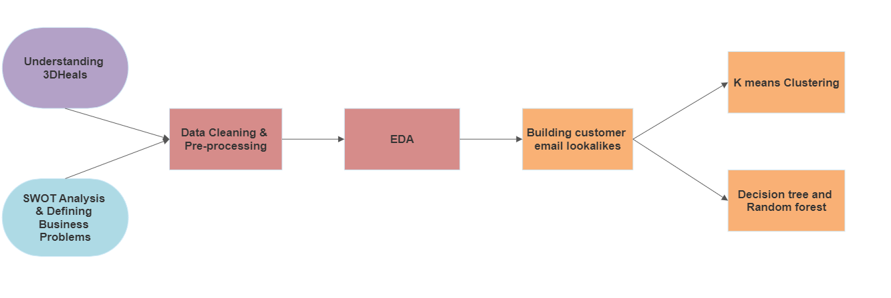
Flow of our Analysis
Notes:
Source(3DHEALS logo): https://logovectordl.com/3dheals-llc-logo-vector-svg/
Source(background): https://www.fastradius.com/resources/video-lattice-design-and-foam-replacement-in-3d-printing/
Color: https://3dheals.com/

Slide 15
Analysis and
synthesis
05
Predictive Model: Building Customer email lookalikes
Notes:
Source(3DHEALS logo): https://logovectordl.com/3dheals-llc-logo-vector-svg/
Source(background): https://www.fastradius.com/resources/video-lattice-design-and-foam-replacement-in-3d-printing/
Color: https://3dheals.com/

Slide 16

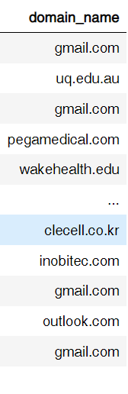


Data Cleaning
Removing unwanted variables
Extracting Domain Name
Removed: 'User Name (Original Name)','First Name','Last Name','Is Guest’, …
From email
01
02
03
Removing empty/missing records
Notes:
Source(3DHEALS logo): https://logovectordl.com/3dheals-llc-logo-vector-svg/
Source(background): https://www.fastradius.com/resources/video-lattice-design-and-foam-replacement-in-3d-printing/
Color: https://3dheals.com/

Slide 17
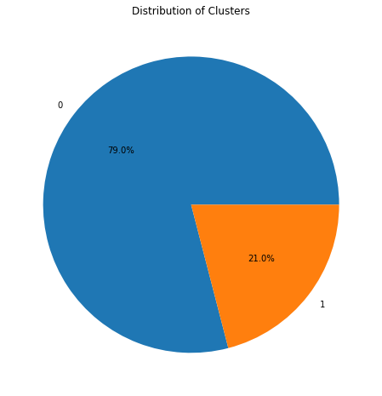
Cluster Ratio
Cluster | Counts | Percent
0 | 2,505 | 79.0%
1 | 573 | 21.0%
Notes:
Source(3DHEALS logo): https://logovectordl.com/3dheals-llc-logo-vector-svg/
Source(background): https://www.fastradius.com/resources/video-lattice-design-and-foam-replacement-in-3d-printing/
Color: https://3dheals.com/

Slide 18
Cluster ‘0’ and Centroids
US
Medical, Pharma, Biotech
VoxCell BioInnovation
United States
Country/Region
Industry
Organization
CEO
Mailchimp
Gmail.com
Job Title
Source Name
Domain_name
Notes:
Source(3DHEALS logo): https://logovectordl.com/3dheals-llc-logo-vector-svg/
Source(background): https://www.fastradius.com/resources/video-lattice-design-and-foam-replacement-in-3d-printing/
Color: https://3dheals.com/

Slide 19
Cluster ‘1’ and Centroids
IN
Education
The Hong Kong Polytechnic University
India
Country/Region
Industry
Organization
Student
Mailchimp
Poly.edu.hk
Job Title
Source Name
Domain_name
Notes:
Source(3DHEALS logo): https://logovectordl.com/3dheals-llc-logo-vector-svg/
Source(background): https://www.fastradius.com/resources/video-lattice-design-and-foam-replacement-in-3d-printing/
Color: https://3dheals.com/

Slide 20
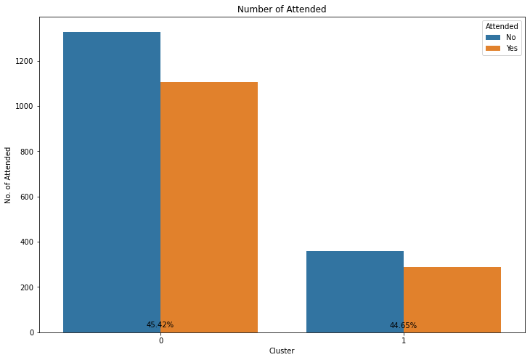
Attended Yes or No
Cluster | Yes Rate
0 | 45.42
1 | 44.55
Notes:
Source(3DHEALS logo): https://logovectordl.com/3dheals-llc-logo-vector-svg/
Source(background): https://www.fastradius.com/resources/video-lattice-design-and-foam-replacement-in-3d-printing/
Color: https://3dheals.com/

Slide 21
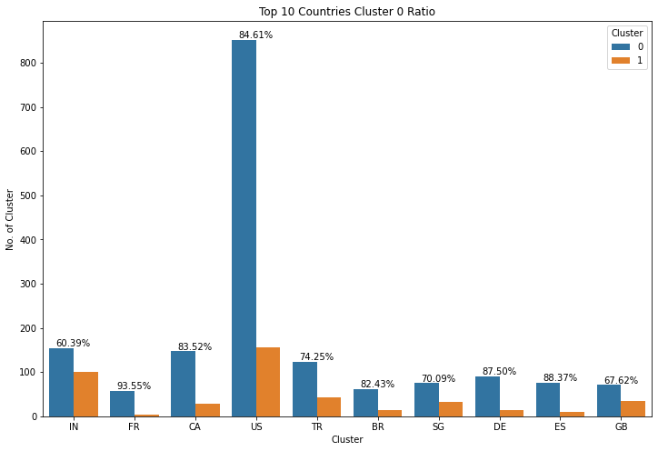
By Countries
Notes:
Source(3DHEALS logo): https://logovectordl.com/3dheals-llc-logo-vector-svg/
Source(background): https://www.fastradius.com/resources/video-lattice-design-and-foam-replacement-in-3d-printing/
Color: https://3dheals.com/

Slide 22
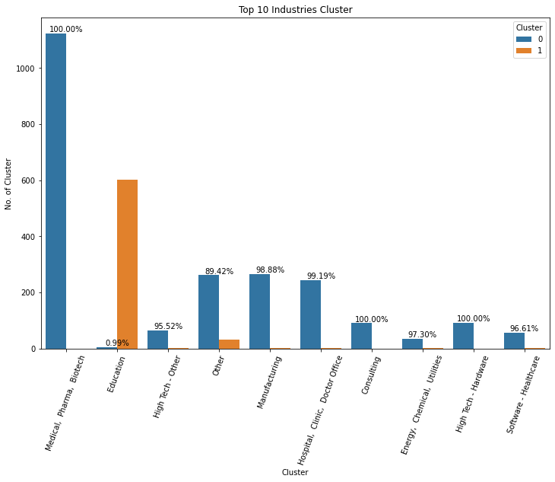
By Industries
Notes:
Source(3DHEALS logo): https://logovectordl.com/3dheals-llc-logo-vector-svg/
Source(background): https://www.fastradius.com/resources/video-lattice-design-and-foam-replacement-in-3d-printing/
Color: https://3dheals.com/

Slide 23
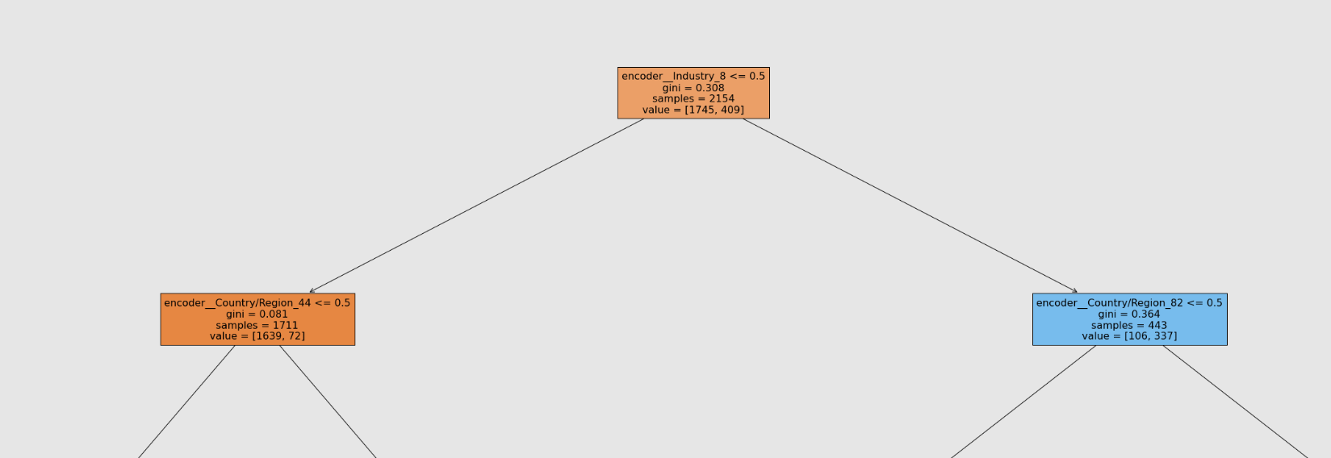
Decision Tree
Industry:
Education
Country/Region:
India
Country/Region:
USA
Notes:
Source(3DHEALS logo): https://logovectordl.com/3dheals-llc-logo-vector-svg/
Source(background): https://www.fastradius.com/resources/video-lattice-design-and-foam-replacement-in-3d-printing/

Slide 24
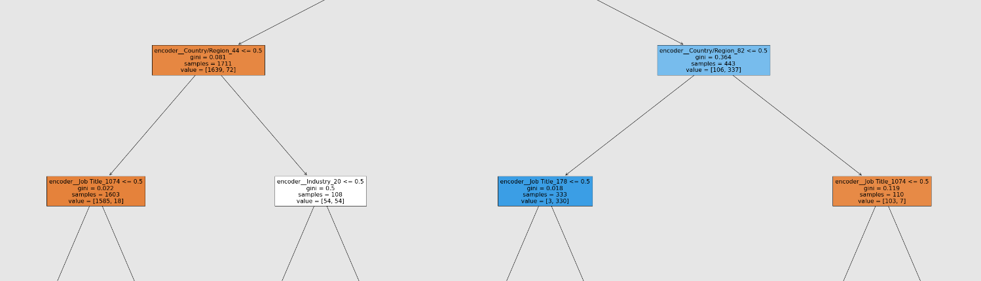
Decision Tree
Country/Region:
India
Country/Region:
USA
Job Title:
Student
Industry:
Medical, Pharma, Biotech
Job Title:
CEO
Job Title:
Student
Notes:
Source(3DHEALS logo): https://logovectordl.com/3dheals-llc-logo-vector-svg/
Source(background): https://www.fastradius.com/resources/video-lattice-design-and-foam-replacement-in-3d-printing/

Slide 25
Decision Tree
Country/Region:
India
Country/Region:
USA
Cluster ‘1’ and Centroids
Cluster ‘0’ and Centroids
IN
US
India
Country/Region
United States
Country/Region
Notes:
Source(3DHEALS logo): https://logovectordl.com/3dheals-llc-logo-vector-svg/
Source(background): https://www.fastradius.com/resources/video-lattice-design-and-foam-replacement-in-3d-printing/

Slide 26
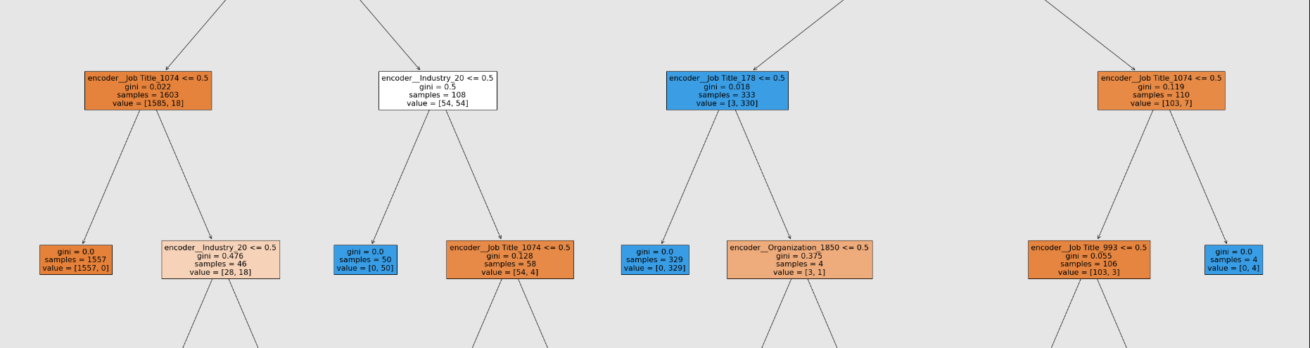
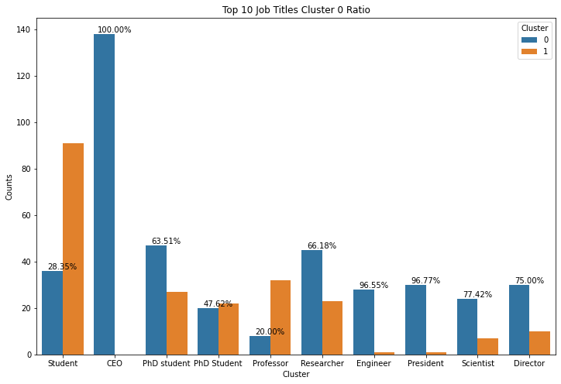
Decision Tree
Job Title:
Student
Industry:
Medical, Pharma, Biotech
Job Title:
CEO
Job Title:
Student
Notes:
Source(3DHEALS logo): https://logovectordl.com/3dheals-llc-logo-vector-svg/
Source(background): https://www.fastradius.com/resources/video-lattice-design-and-foam-replacement-in-3d-printing/

Slide 27
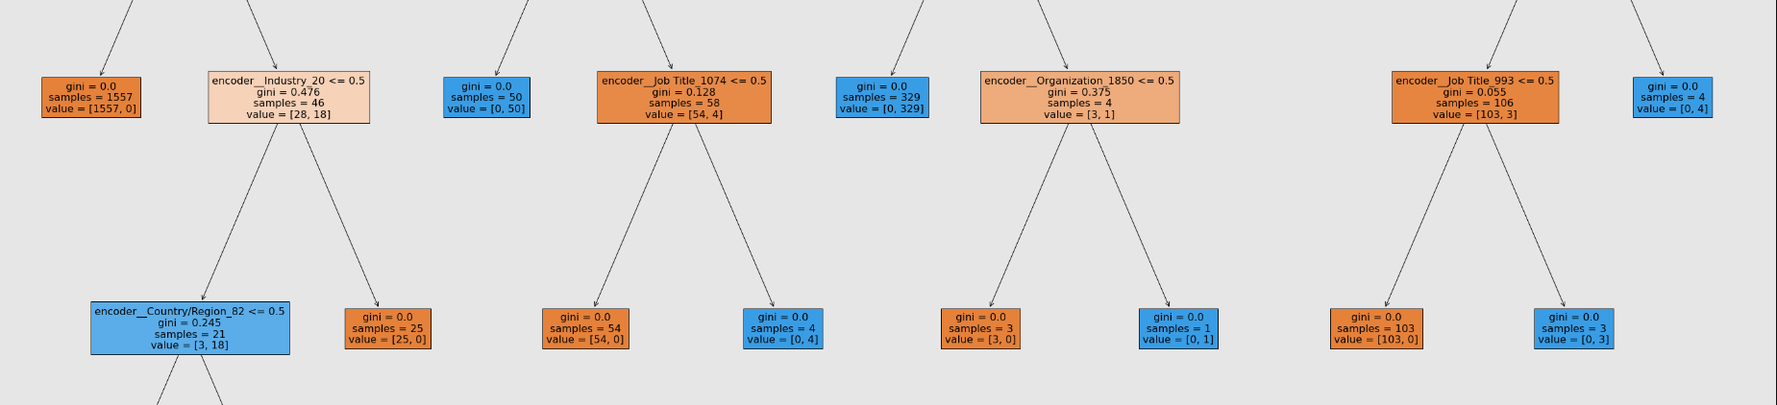
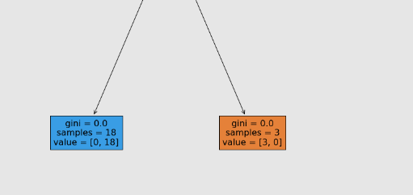
Decision Tree
Industry:
Medical, Pharma, Biotech
Job Title:
Student
Organization:
wow3dlearning
Job Title:
Researcher
Country/Region:
USA
Notes:
Source(3DHEALS logo): https://logovectordl.com/3dheals-llc-logo-vector-svg/
Source(background): https://www.fastradius.com/resources/video-lattice-design-and-foam-replacement-in-3d-printing/

Slide 28
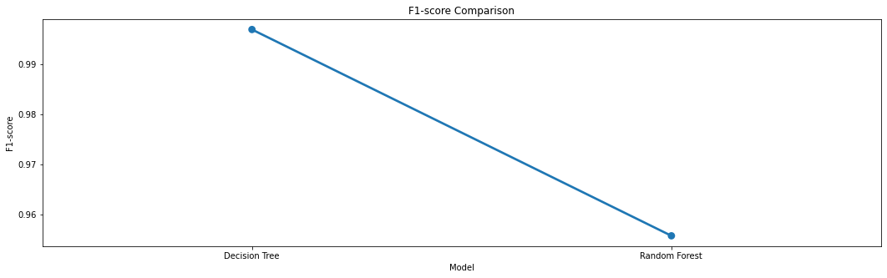
F-1 Score comparison
Notes:
Source(3DHEALS logo): https://logovectordl.com/3dheals-llc-logo-vector-svg/
Source(background): https://www.fastradius.com/resources/video-lattice-design-and-foam-replacement-in-3d-printing/

Slide 29
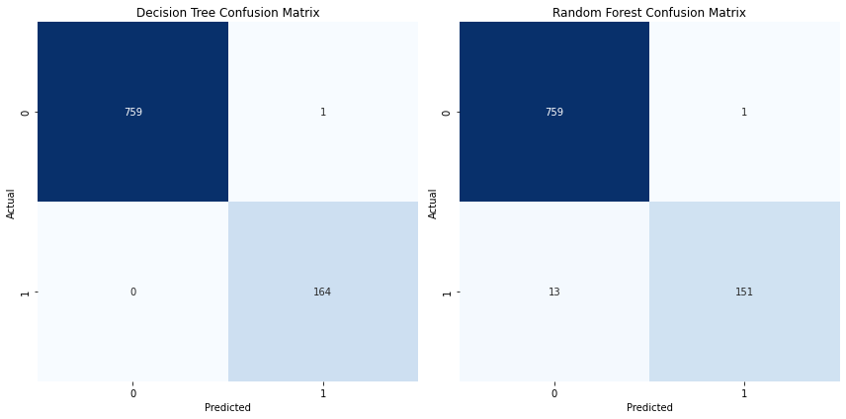
Confusion Matrix
Notes:
Source(3DHEALS logo): https://logovectordl.com/3dheals-llc-logo-vector-svg/
Source(background): https://www.fastradius.com/resources/video-lattice-design-and-foam-replacement-in-3d-printing/

Slide 30
Recommendations
& Findings
06
Notes:
Source(3DHEALS logo): https://logovectordl.com/3dheals-llc-logo-vector-svg/
Source(background): https://www.fastradius.com/resources/video-lattice-design-and-foam-replacement-in-3d-printing/
Color: https://3dheals.com/

Slide 31
Recommendations
Customized Marketing: Leverage attendee segmentation for designing personalized marketing strategies to increase engagement and event attendance.
Predictive Modelling: Employ predictive models to forecast event attendance for efficient resource planning and management.
Event Timing and Content: Evaluate session/webinar engagement to identify areas for content enhancement or timing adjustment.
Data Privacy Considerations: Maintain respect for data privacy, exploring alternatives if attendees express discomfort with recording or information sharing.
Sponsorship Collaboration: Analyze sponsor influence on event attendance for potential strategic collaborations.
Geographic Targeting: Consider focusing on regions with higher attendance rates for event hosting or increased marketing efforts.
Marketing Channels: Assess the effectiveness of various marketing channels to concentrate efforts on the most impactful ones.
Feedback Analysis: Apply natural language processing techniques to 'Questions & Comments' for valuable attendee sentiment analysis and direct feedback.
Notes:
Source(3DHEALS logo): https://logovectordl.com/3dheals-llc-logo-vector-svg/
Source(background): https://www.fastradius.com/resources/video-lattice-design-and-foam-replacement-in-3d-printing/
Color: https://3dheals.com/

Slide 32
Finding: Centroids
Cluster ‘0’
Cluster ‘1’
Country/Region
US
IN
United States
India
Industry
Medical, Pharma, Biotech
Education
Organization
VoxCell BioInnovation
The Hong Kong Polytechnic University
Organization
CEO
Student
Source Name
Mailchimp
Mailchimp
Domain
Gmail.com
Poly.edu.hk
Notes:
Source(3DHEALS logo): https://logovectordl.com/3dheals-llc-logo-vector-svg/
Source(background): https://www.fastradius.com/resources/video-lattice-design-and-foam-replacement-in-3d-printing/
Color: https://3dheals.com/

Slide 33
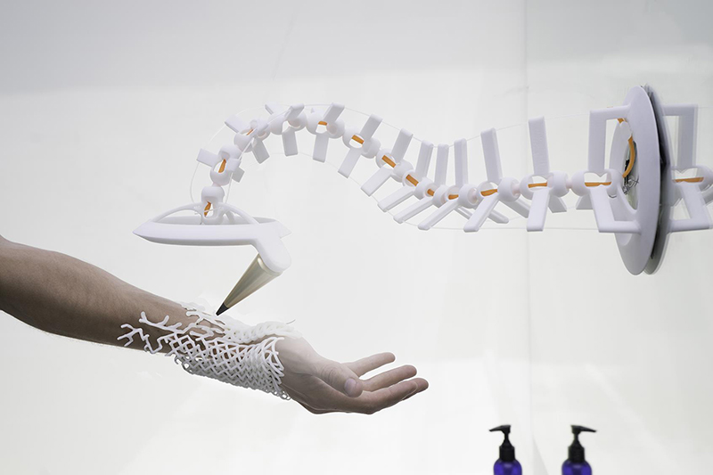
Q&A
Q&A
Thank you!
Notes:
Source: https://www.upgrade100.com/updates/the-boundaries-of-3d-printing-in-healthcare/
Source(3DHEALS logo): https://logovectordl.com/3dheals-llc-logo-vector-svg/
Color: https://3dheals.com/

Slide 34
REFERENCE
3DHEALS. (n.d.). About us. Retrieved from https://3dheals.com/about-us
Deloitte. (2020). 2020 global health care outlook: Laying a foundation for the future. Retrieved from https://www2.deloitte.com/us/en/pages/life-sciences-and-health-care/articles/global-health-care-sector-outlook.html
Machado, L. (2018, August 20). Artificial intelligence and 3D printing. Medium. https://medium.com/healthcare-3d-printing-stories/artificial-intelligence-and-3d-printing-94f45f3e45dd
PwC. (2019). What's next for the pharmaceuticals industry, amid digital disruption and rapid technological advances? Retrieved from https://www.pwc.com/gx/en/pharma-life-sciences/pdf/pwc-pharma-2020.pdf
Statista. (2021). 3D printing - Statistics & Facts. Retrieved from https://www.statista.com/topics/1174/3d-printing
3D Systems. (n.d.). Healthcare. Retrieved from https://www.3dsystems.com/healthcare
3DHEALS. (n.d.). About us. Retrieved from https://3dheals.com/about
Gartner. (2018). Gartner says 3D printing is changing the landscape of the medical device market. Retrieved from https://www.gartner.com/en/newsroom/press-releases/2018-04-03-gartner-says-3d-printing-is-changing-the-landscape-of-the-medical-device-market
Huang, S. H., Liu, P., Mokasdar, A., & Hou, L. (2020). Additive manufacturing and its societal impact: A literature review. The International Journal of Advanced Manufacturing Technology, 67(5-8), 1191-1203. doi: 10.1007/s00170-012-4558-5
Notes:
Source: https://www.upgrade100.com/updates/the-boundaries-of-3d-printing-in-healthcare/

Slide 35
REFERENCE
Organovo. (n.d.). About Organovo. Retrieved from https://organovo.com/about/Rengier, F., Mehndiratta, A., von Tengg-Kobligk, H., Zechmann, C. M., Unterhinninghofen, R.,Kauczor, H. U., & Giesel, F. L. (2010). 3D printing based on imaging data: Review of medical applications. International Journal of Computer Assisted Radiology and Surgery, 5(4), 335-341.doi: 10.1007/s11548-010-0476-x
Stratasys. (n.d.). Medical solutions. Retrieved from https://www.stratasys.com/medical
Suganya Karunamurthy. (2022). K-Mode Clustering | solved example | implementation. YouTube. Retrieved from https://www.youtube.com/watch?v=EVl2ejcsTfg
Harika Bonthu. (2021, June 13). KModes Clustering algorithm for categorical data. Analytics Vidhya. Retrieved from https://www.analyticsvidhya.com/blog/2021/06/kmodes-clustering-algorithm-for-categorical-data/#h-2-scree-plot-or-elbow-curve-to-find-optimal-kvalue
PRASHANT BANERJEE. (2022). K-Means clustering with Python. Kaggle. Retrieved from https://www.kaggle.com/code/prashant111/k-means-clustering-with-python
ASHISH. (2020). Bank customer clustering (K-Modes Clustering). Kaggle. Retrieved from https://www.kaggle.com/code/ashydv/bank-customer-clustering-k-modes-clustering/notebook
rakshithvasudev. (2017, August 2). What is one hot encoding? why and when do you have to use it?. Hackernoon. Retrieved from https://hackernoon.com/what-is-one-hot-encoding-why-and-when-do-you-have-to-use-it-e3c6186d008f
Notes:
Source: https://www.upgrade100.com/updates/the-boundaries-of-3d-printing-in-healthcare/

Slide 36
Appendix 1
Exploratory Data Analysis
Notes:
Source(3DHEALS logo): https://logovectordl.com/3dheals-llc-logo-vector-svg/
Source(background): https://www.fastradius.com/resources/video-lattice-design-and-foam-replacement-in-3d-printing/
Color: https://3dheals.com/

Slide 37
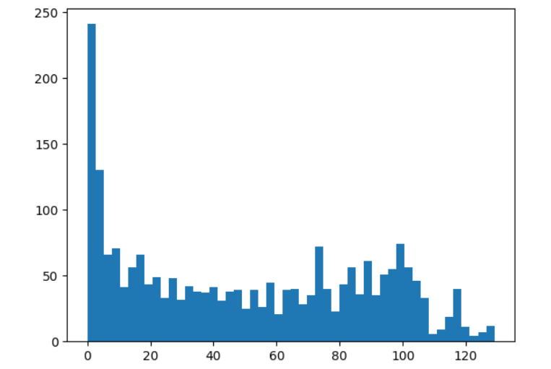
Time in Session (minutes)
Count: 2229.0
Mean: 50.4
Std: 37.9
Min: 0.0
25%: 13.0
50%: 47.0
75%: 85.0
Max: 129.0
APPENDIX
Notes:
Source(background): https://www.fastradius.com/resources/video-lattice-design-and-foam-replacement-in-3d-printing/
Color: https://3dheals.com/

Slide 38
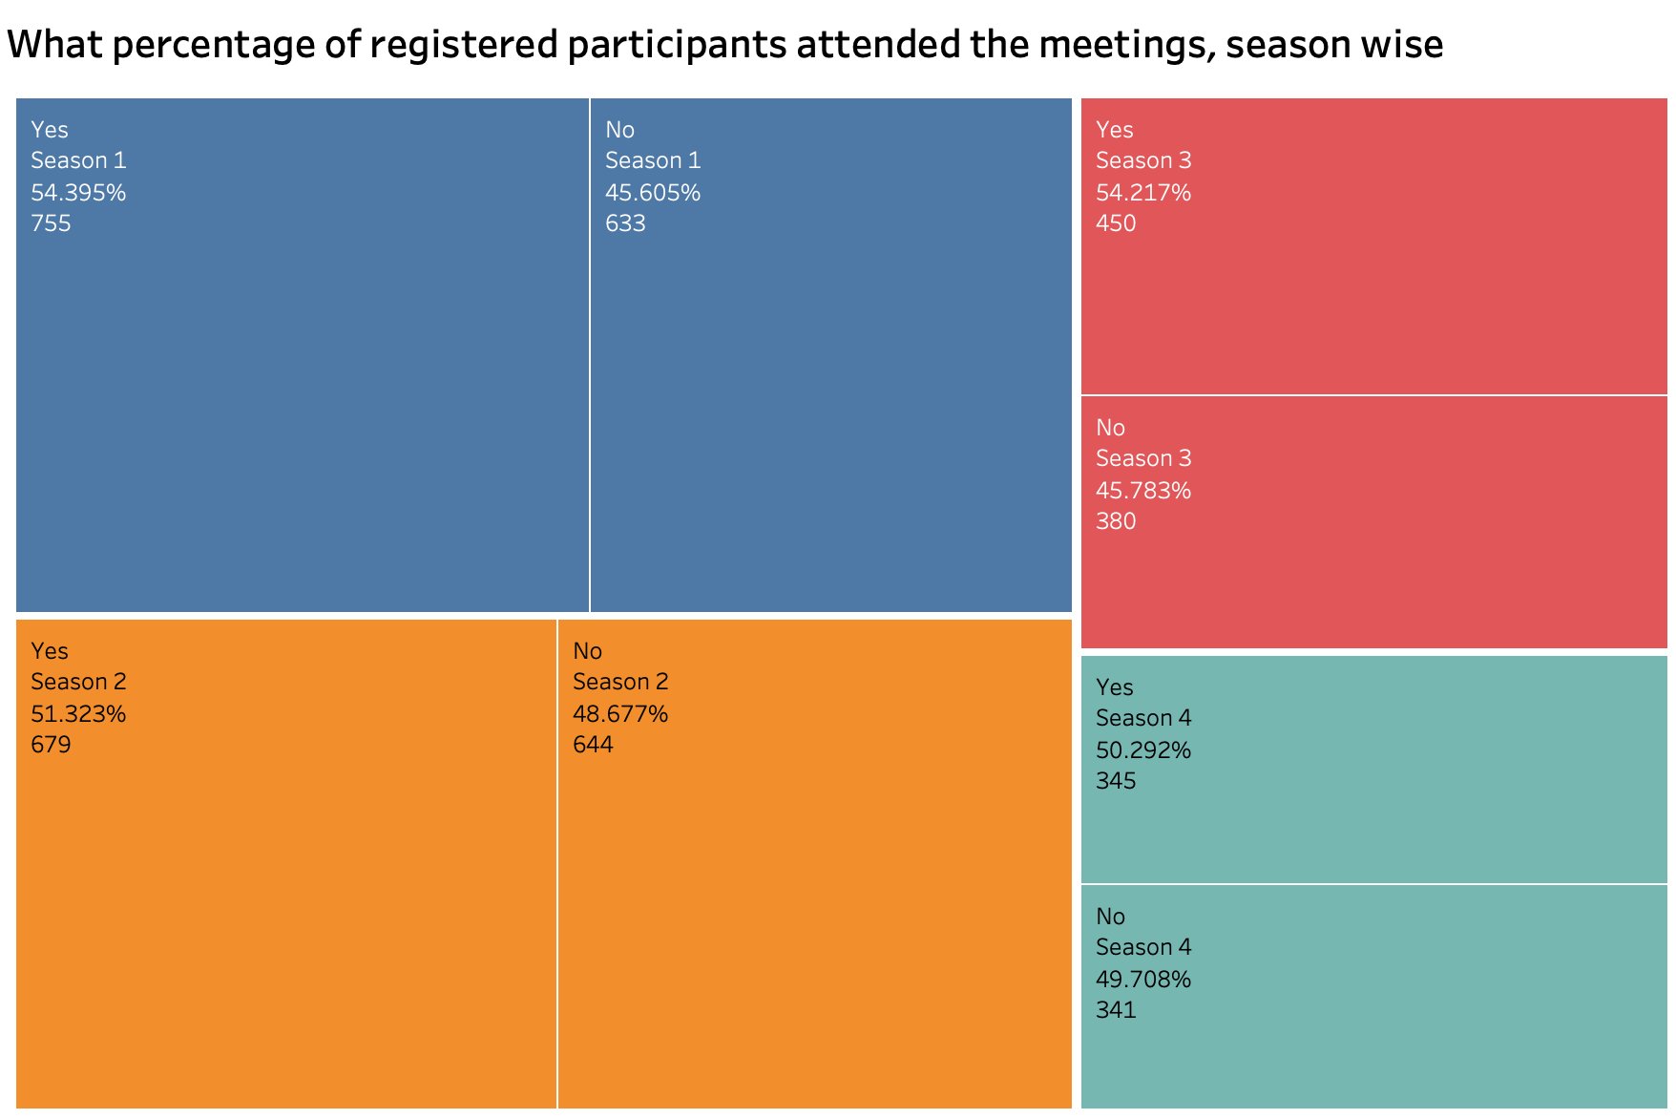
Season wise, Attended
APPENDIX
Notes:
Source(background): https://www.fastradius.com/resources/video-lattice-design-and-foam-replacement-in-3d-printing/
Color: https://3dheals.com/

Slide 39
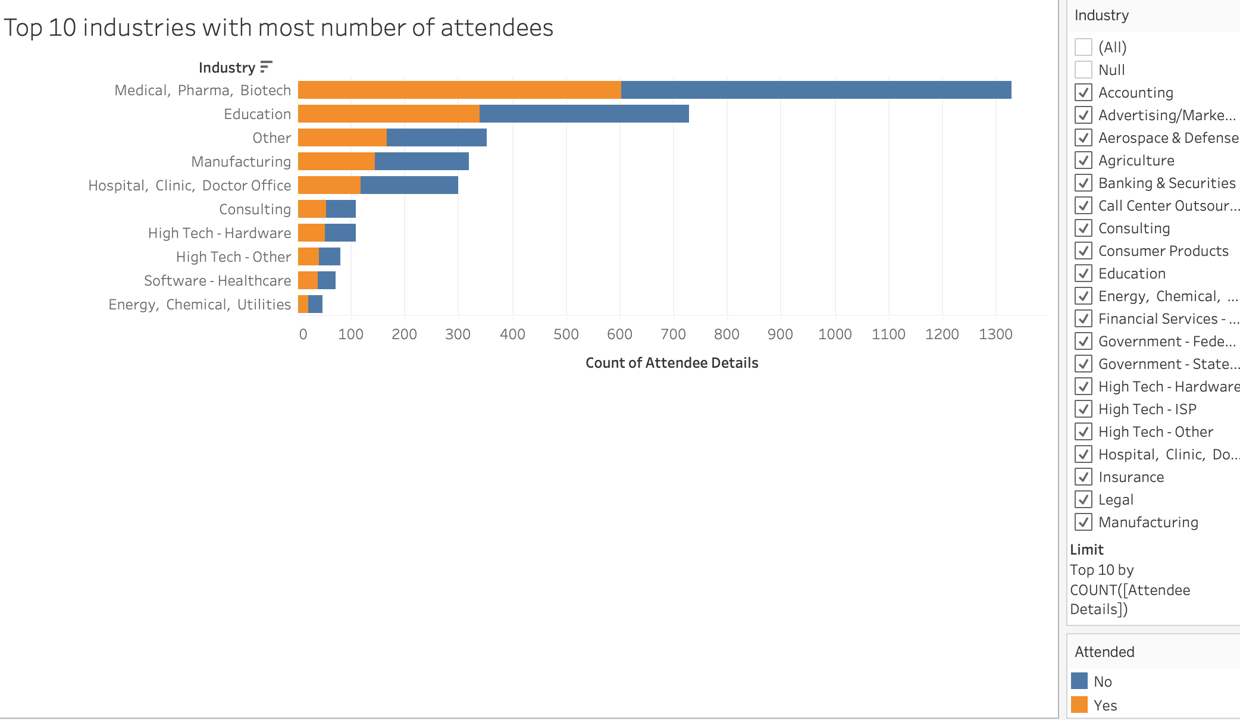
Top 10 industries with most attendees
APPENDIX
Notes:
Source(background): https://www.fastradius.com/resources/video-lattice-design-and-foam-replacement-in-3d-printing/
Color: https://3dheals.com/

Slide 40
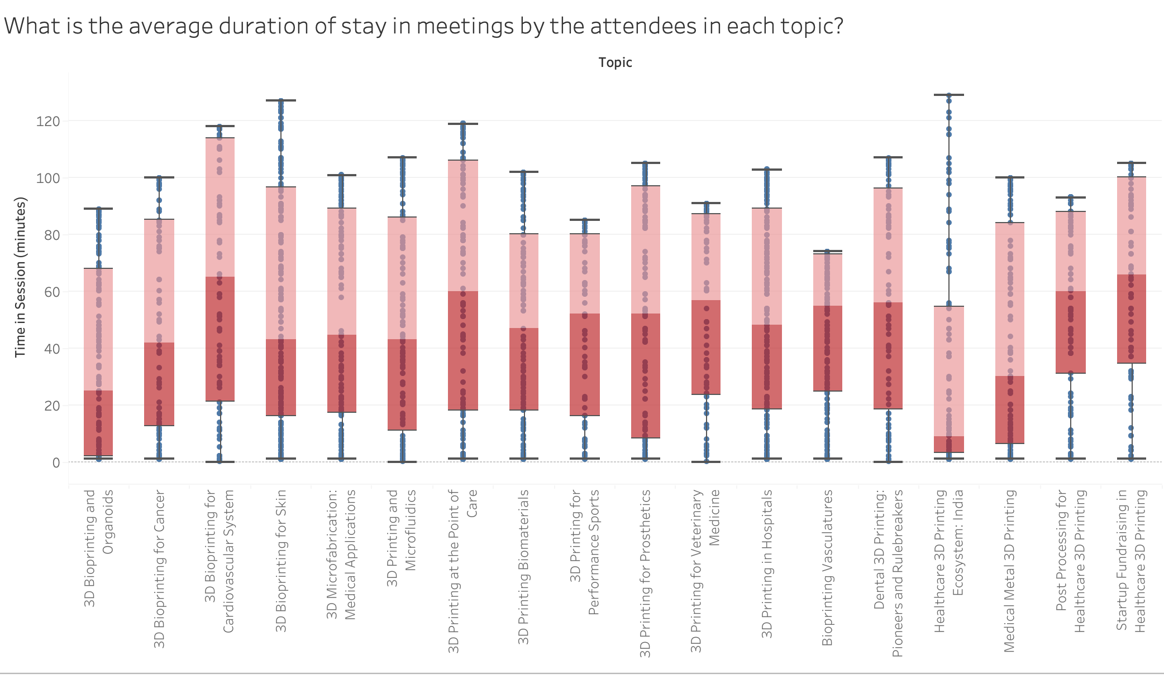
Average Duration
APPENDIX
Notes:
Source(background): https://www.fastradius.com/resources/video-lattice-design-and-foam-replacement-in-3d-printing/
Color: https://3dheals.com/

Slide 41
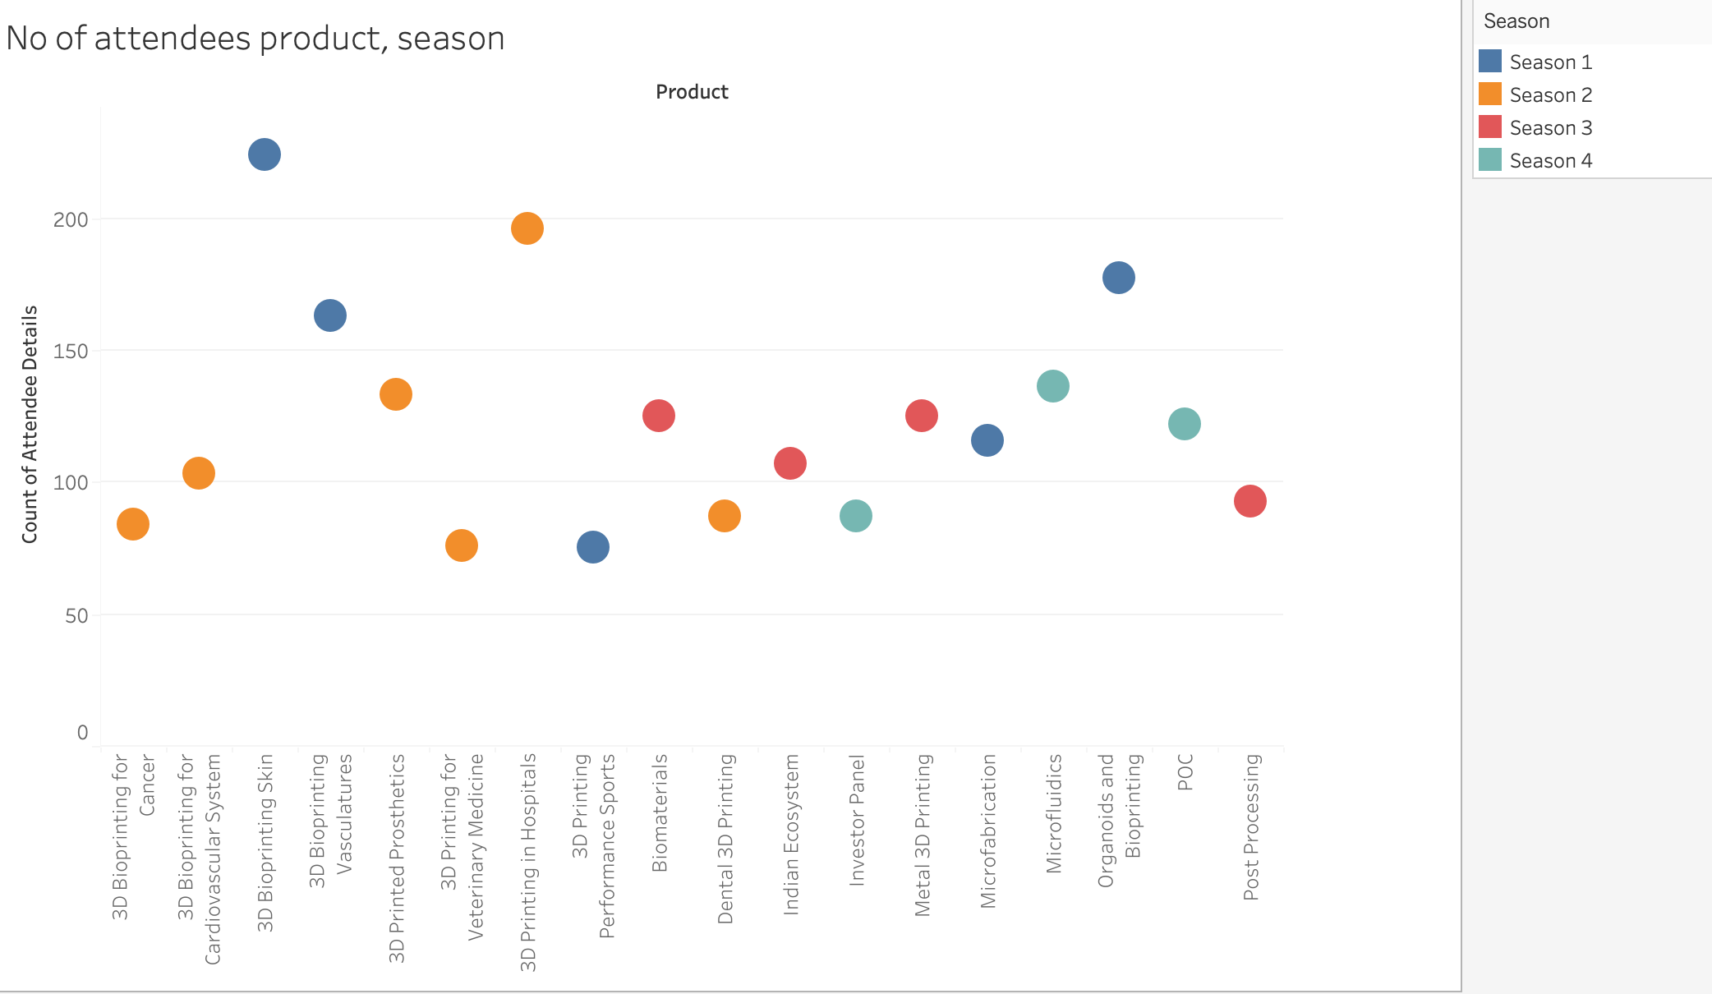
Num of Attendees by product & Season
APPENDIX
Notes:
Source(background): https://www.fastradius.com/resources/video-lattice-design-and-foam-replacement-in-3d-printing/
Color: https://3dheals.com/

Slide 42
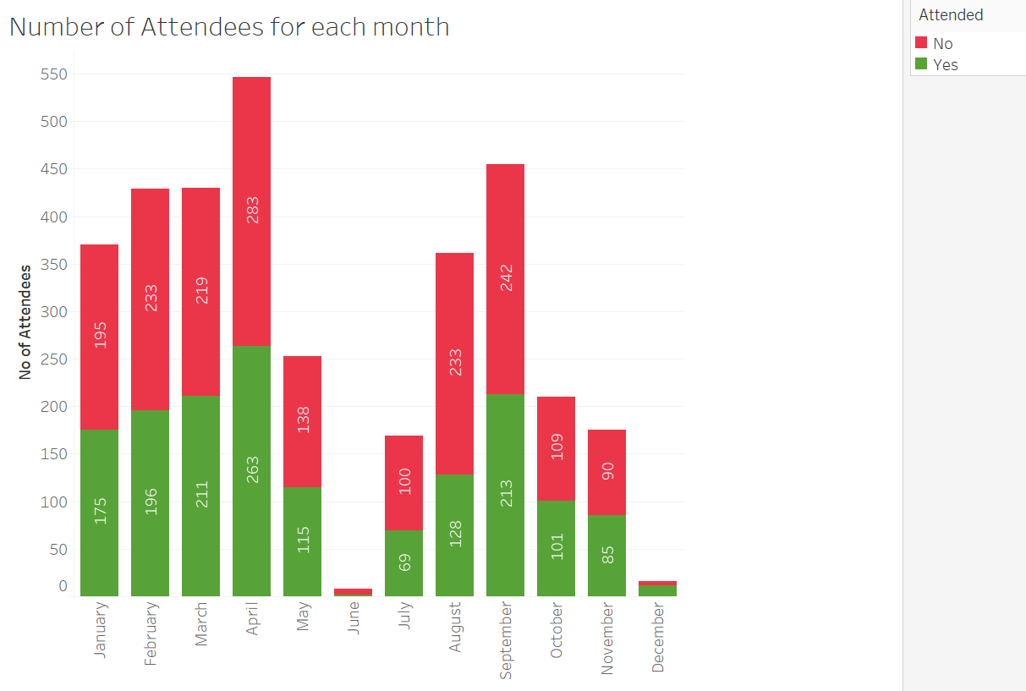
Attendees for each month
APPENDIX
Notes:
Source(background): https://www.fastradius.com/resources/video-lattice-design-and-foam-replacement-in-3d-printing/
Color: https://3dheals.com/

Slide 43
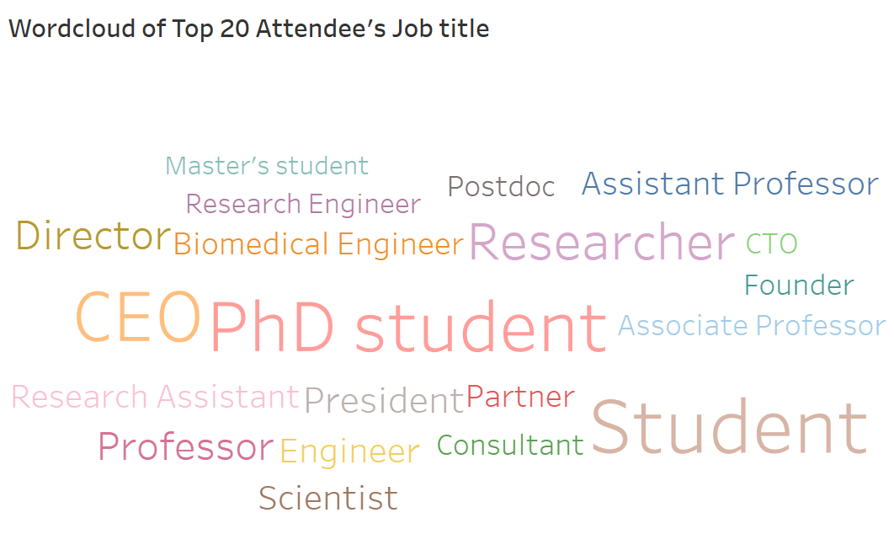
Wordcloud of Top 20 Attendee’s Job title
APPENDIX
Notes:
Source(background): https://www.fastradius.com/resources/video-lattice-design-and-foam-replacement-in-3d-printing/
Color: https://3dheals.com/

Slide 44
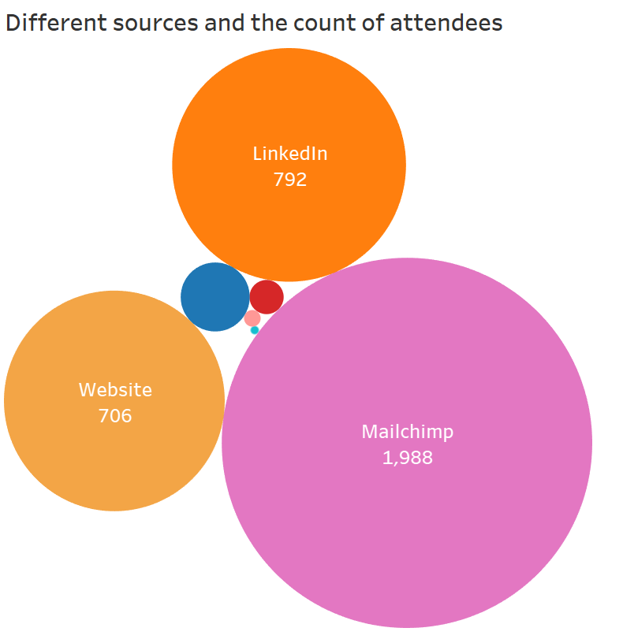
Count of attendess by different source
APPENDIX
Notes:
Source(background): https://www.fastradius.com/resources/video-lattice-design-and-foam-replacement-in-3d-printing/
Color: https://3dheals.com/

Slide 45
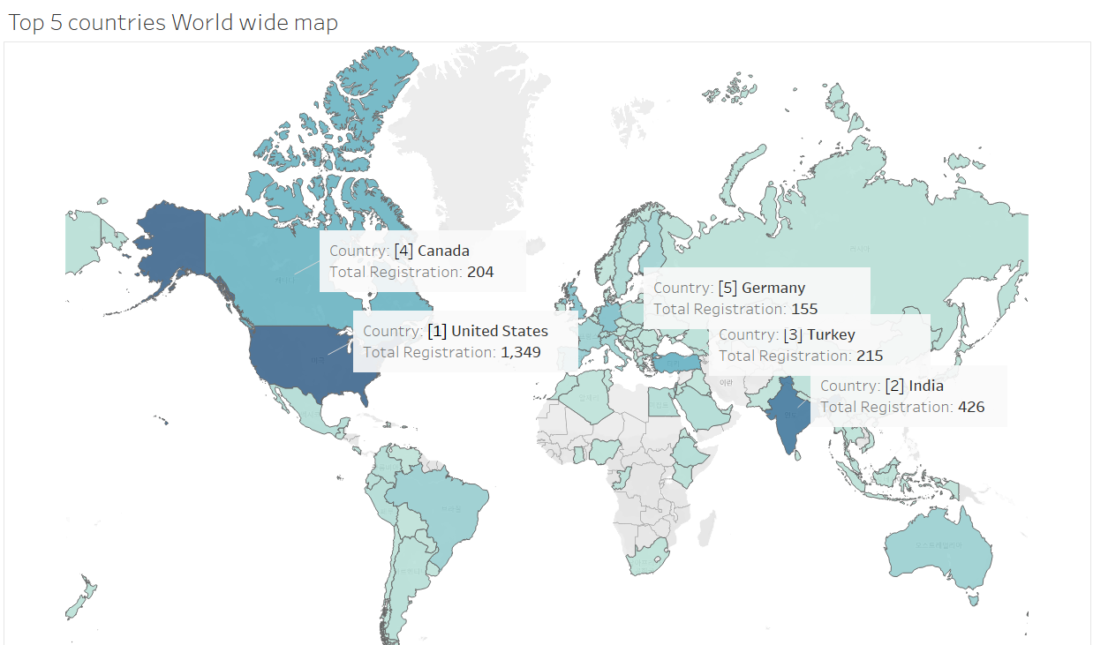
Top 5 Countries by Registration
APPENDIX
Notes:
Source(background): https://www.fastradius.com/resources/video-lattice-design-and-foam-replacement-in-3d-printing/
Color: https://3dheals.com/

Slide 46
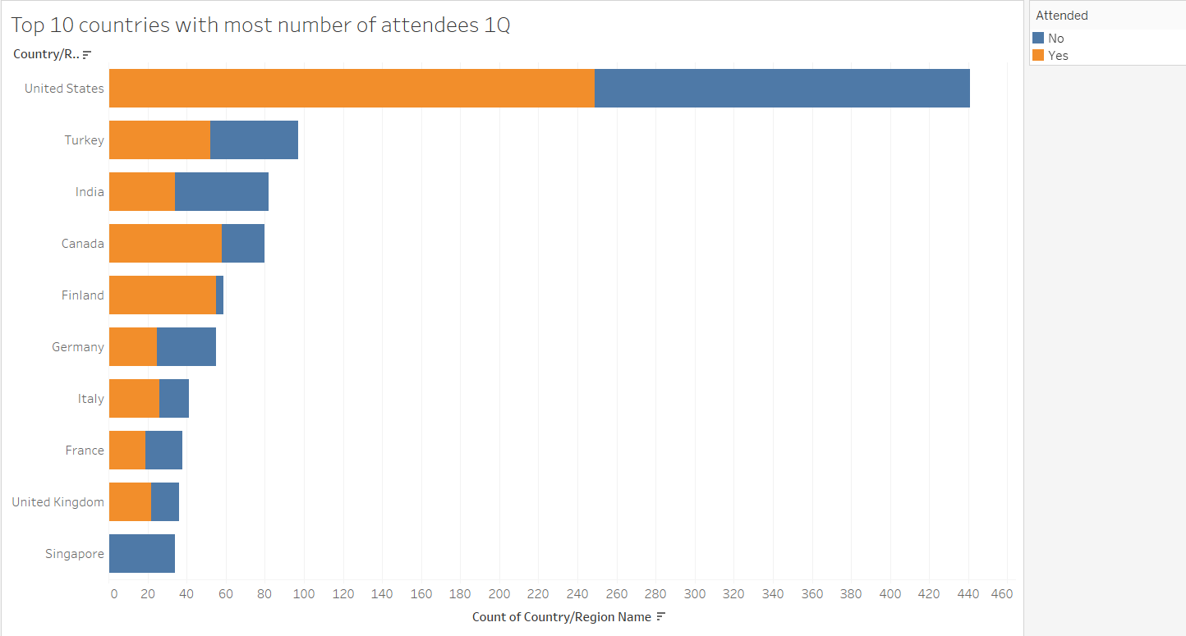
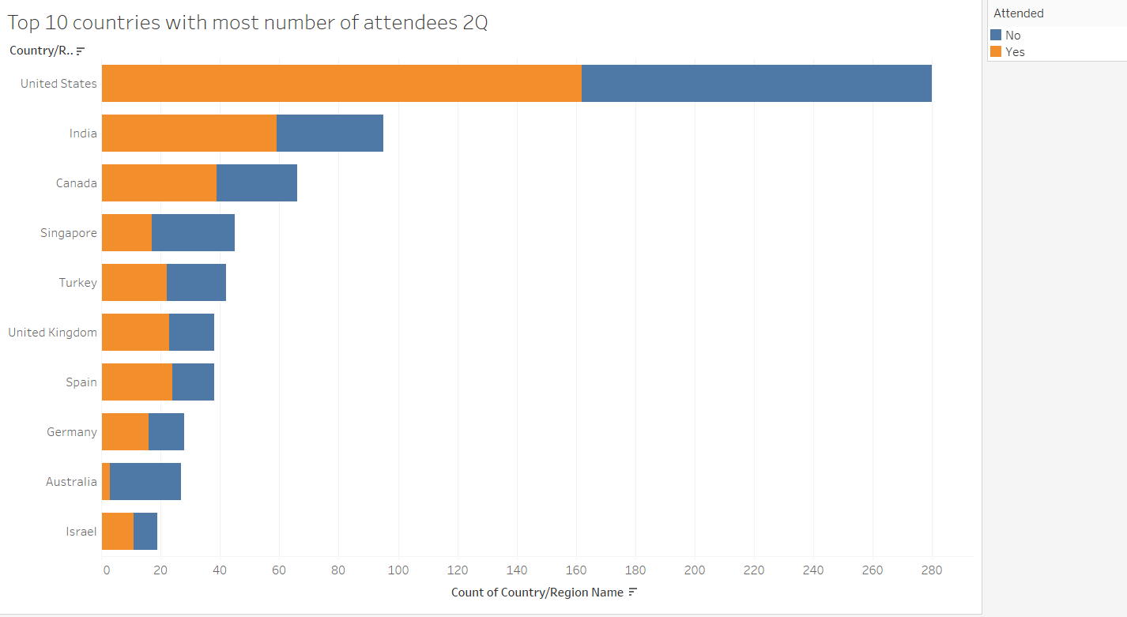
APPENDIX
Notes:
Source(background): https://www.fastradius.com/resources/video-lattice-design-and-foam-replacement-in-3d-printing/
Color: https://3dheals.com/

Slide 47
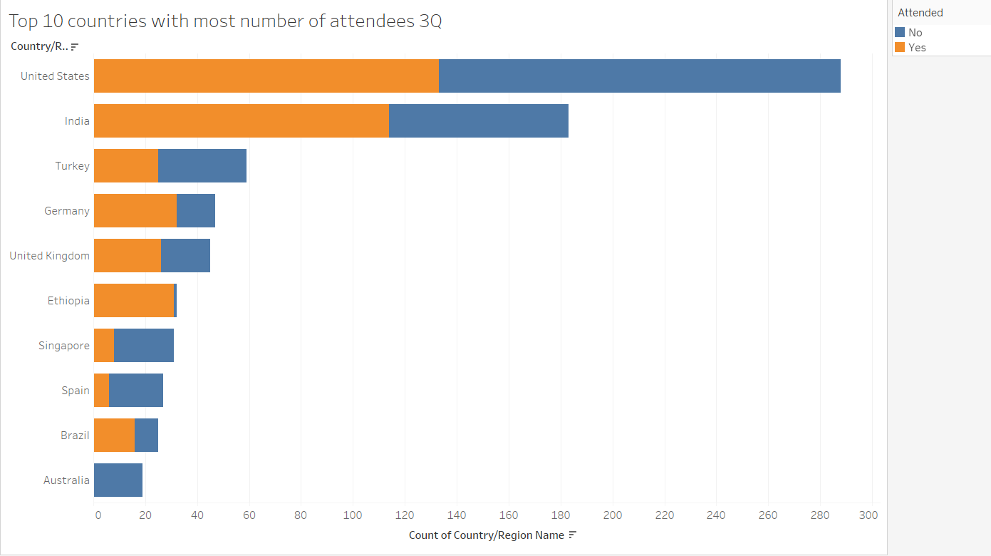
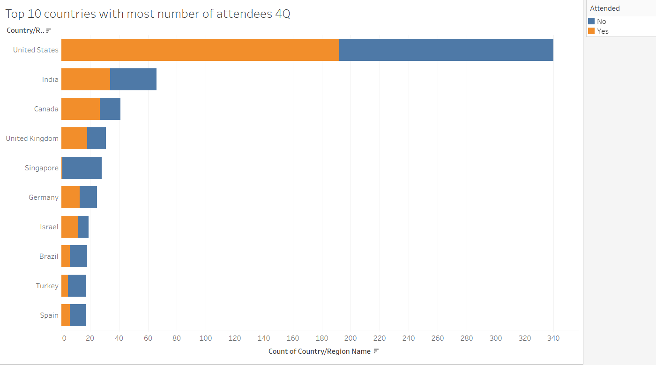
APPENDIX
Notes:
Source(background): https://www.fastradius.com/resources/video-lattice-design-and-foam-replacement-in-3d-printing/
Color: https://3dheals.com/

Slide 48
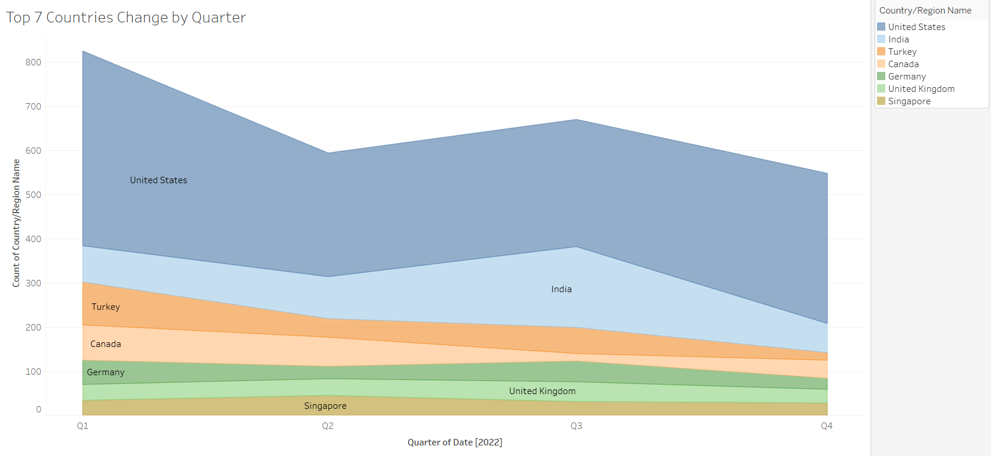
Top 7 Countries by quarter
APPENDIX
Notes:
Source(background): https://www.fastradius.com/resources/video-lattice-design-and-foam-replacement-in-3d-printing/
Color: https://3dheals.com/

Slide 49
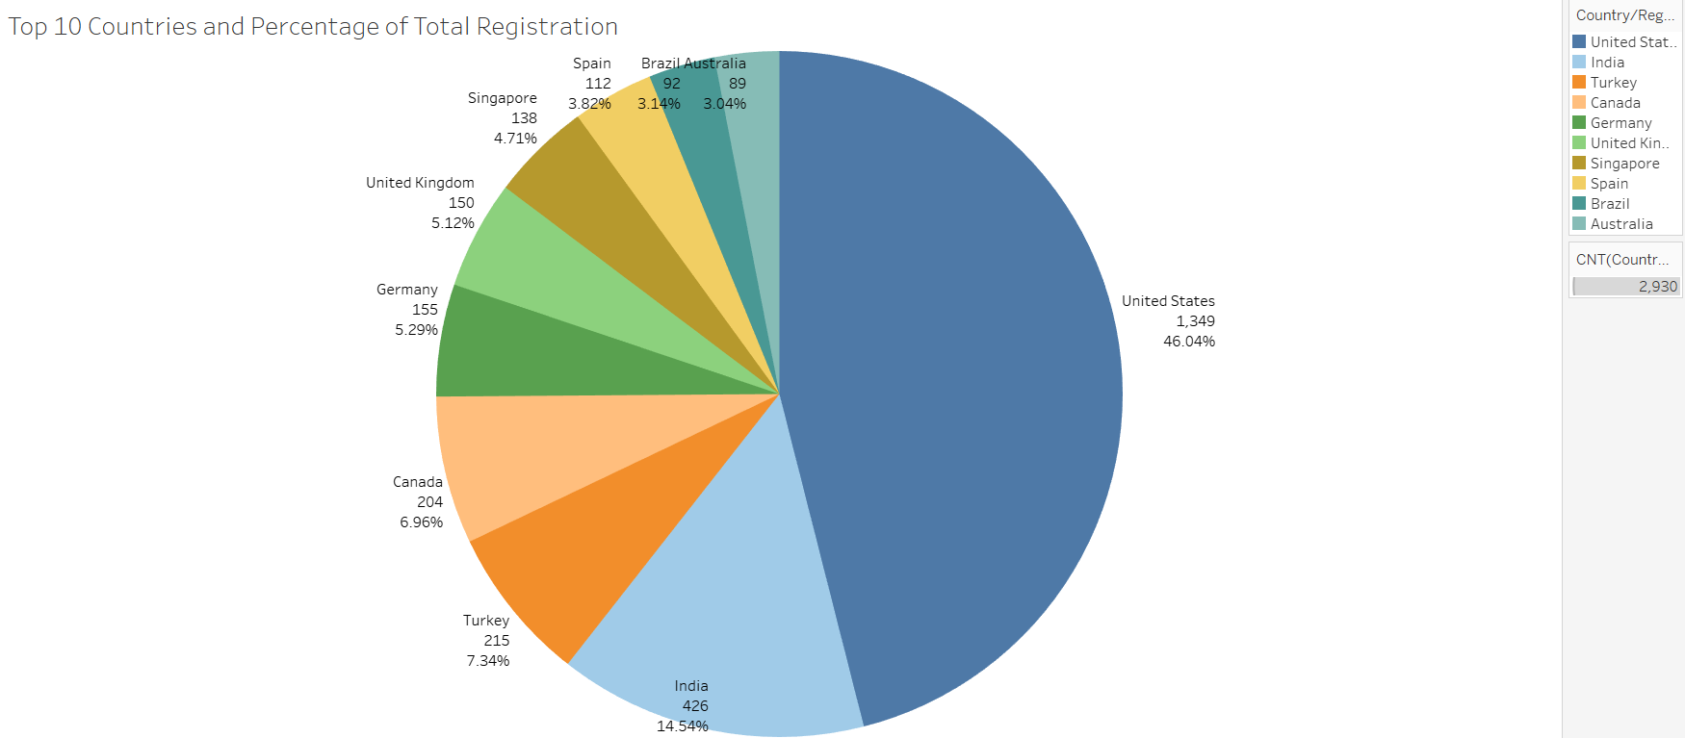
Pie Chart of Top 10 Countries
APPENDIX
Notes:
Source(background): https://www.fastradius.com/resources/video-lattice-design-and-foam-replacement-in-3d-printing/
Color: https://3dheals.com/

Slide 50
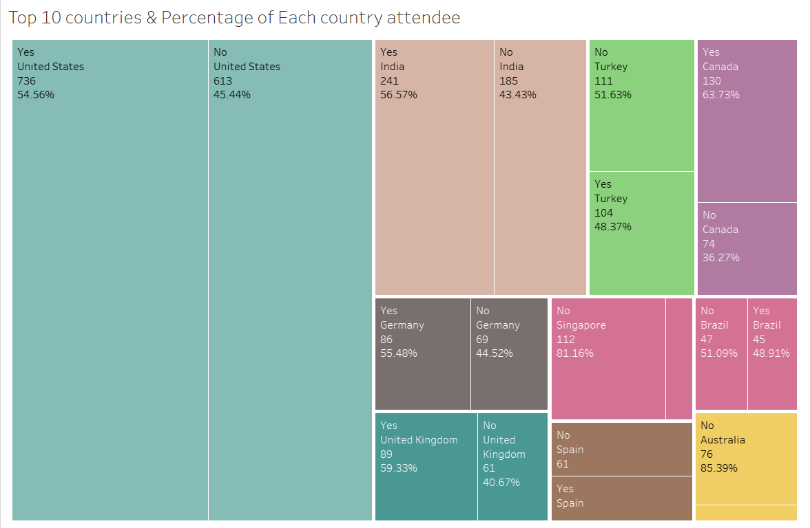
Top 10 countries & percentage of attendee
APPENDIX
Notes:
Source(background): https://www.fastradius.com/resources/video-lattice-design-and-foam-replacement-in-3d-printing/
Color: https://3dheals.com/

Slide 51
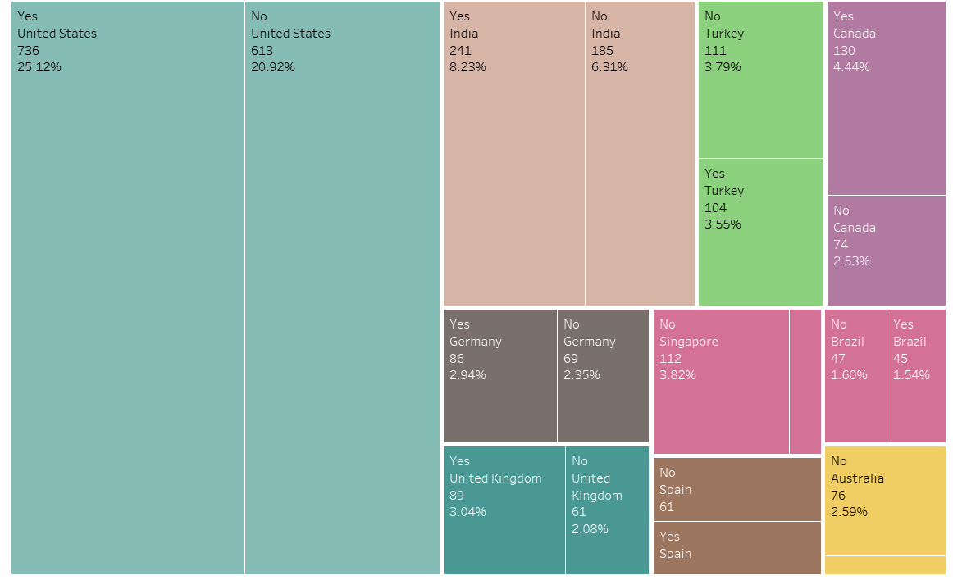
Top 10 countries & percentage of Total attendee
APPENDIX
Notes:
Source(background): https://www.fastradius.com/resources/video-lattice-design-and-foam-replacement-in-3d-printing/
Color: https://3dheals.com/

Slide 52
Appendix 2
Clustering Visualization
Notes:
Source(3DHEALS logo): https://logovectordl.com/3dheals-llc-logo-vector-svg/
Source(background): https://www.fastradius.com/resources/video-lattice-design-and-foam-replacement-in-3d-printing/
Color: https://3dheals.com/

Slide 53
Attended Yes or No
Cluster | Yes Rate
0 | 45.42
1 | 44.55
Notes:
Source(3DHEALS logo): https://logovectordl.com/3dheals-llc-logo-vector-svg/
Source(background): https://www.fastradius.com/resources/video-lattice-design-and-foam-replacement-in-3d-printing/
Color: https://3dheals.com/

Slide 54
By Countries
Notes:
Source(3DHEALS logo): https://logovectordl.com/3dheals-llc-logo-vector-svg/
Source(background): https://www.fastradius.com/resources/video-lattice-design-and-foam-replacement-in-3d-printing/
Color: https://3dheals.com/

Slide 55
By Industries
Notes:
Source(3DHEALS logo): https://logovectordl.com/3dheals-llc-logo-vector-svg/
Source(background): https://www.fastradius.com/resources/video-lattice-design-and-foam-replacement-in-3d-printing/
Color: https://3dheals.com/

Slide 56
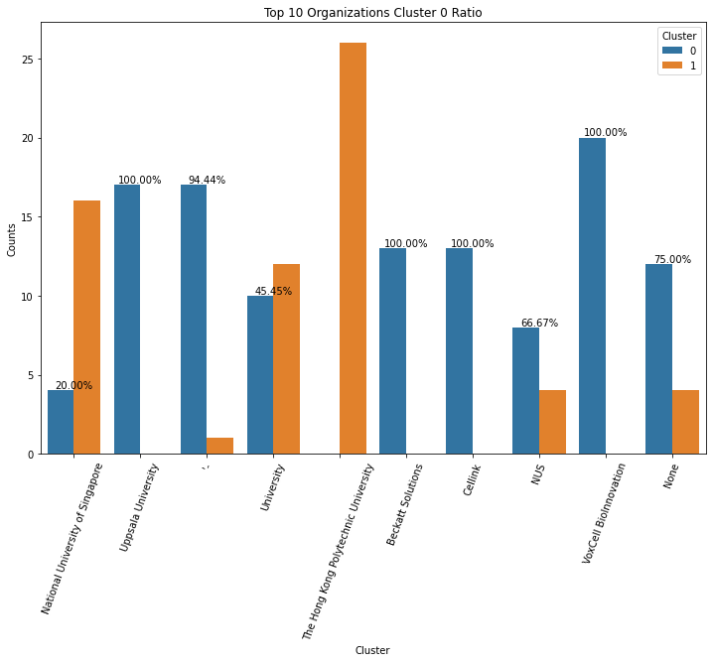
By Organizations
Notes:
Source(3DHEALS logo): https://logovectordl.com/3dheals-llc-logo-vector-svg/
Source(background): https://www.fastradius.com/resources/video-lattice-design-and-foam-replacement-in-3d-printing/
Color: https://3dheals.com/

Slide 57
By Job Titles
Notes:
Source(3DHEALS logo): https://logovectordl.com/3dheals-llc-logo-vector-svg/
Source(background): https://www.fastradius.com/resources/video-lattice-design-and-foam-replacement-in-3d-printing/
Color: https://3dheals.com/

Slide 58
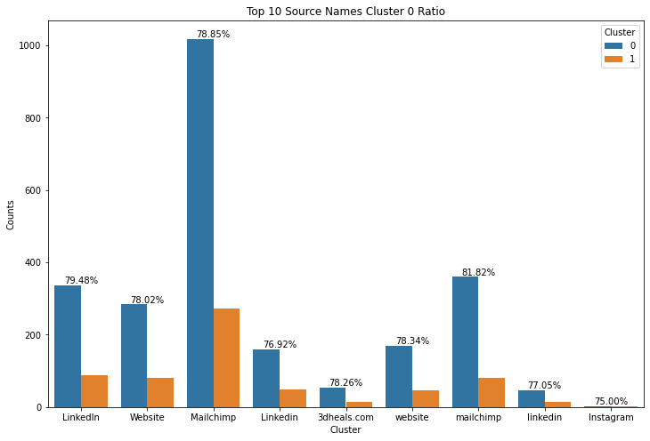
By Source Name
Notes:
Source(3DHEALS logo): https://logovectordl.com/3dheals-llc-logo-vector-svg/
Source(background): https://www.fastradius.com/resources/video-lattice-design-and-foam-replacement-in-3d-printing/
Color: https://3dheals.com/

Slide 59
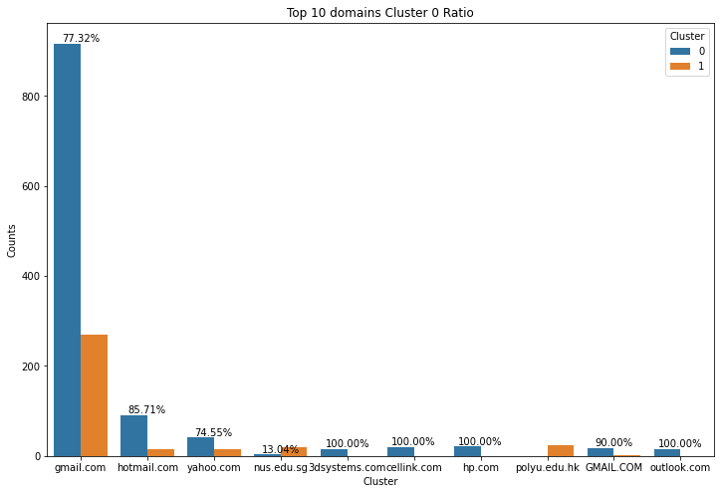
By Domain_name
Notes:
Source(3DHEALS logo): https://logovectordl.com/3dheals-llc-logo-vector-svg/
Source(background): https://www.fastradius.com/resources/video-lattice-design-and-foam-replacement-in-3d-printing/
Color: https://3dheals.com/

